Slide 1
Crop analysis and pesticides Recommendation system
Mr. Devdas - Guide

Slide 2
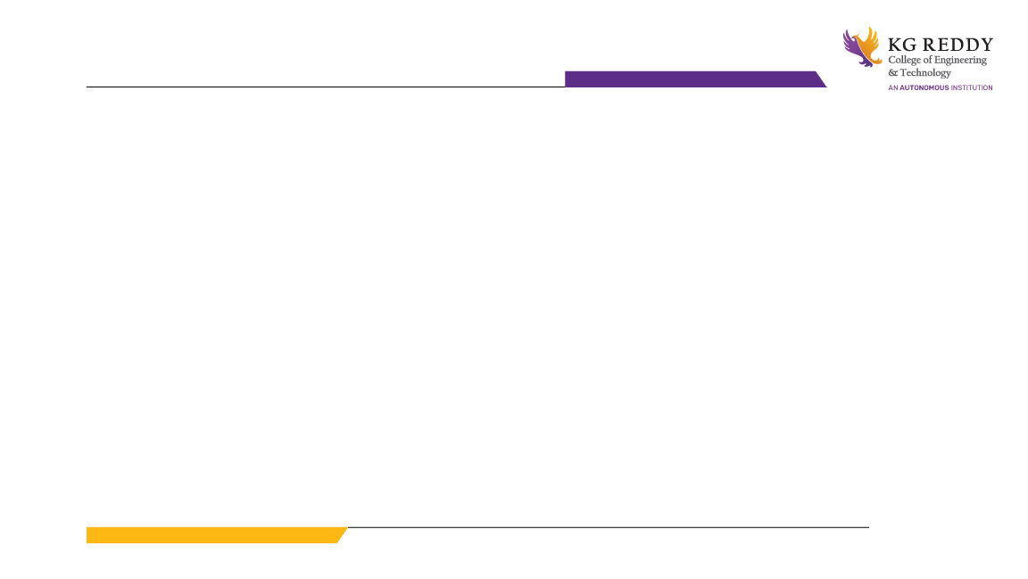
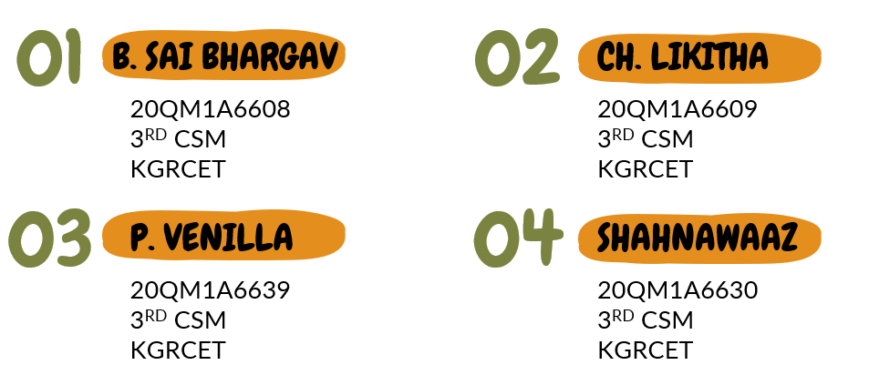
MINI PROJECT GROUP 7

Slide 3
Tittle of the Project :
“ Crop Analysis and pesticides Recommendation system ”

Slide 4
Problem Statement :
Many farmers in India don’t know what type of crops they need to grow on their farm depending on their soil conditions and the water resources available in their village.
Due to these unknown conditions, they try to grow different types of crops but fail to harvest a good yield.
They don’t know what type and amount of pesticides, insecticides and fertilizers that crops in the farm require.
They also don’t know how to segregate issues like which crop requires fertilizer's, pesticides, and insecticides.
Hence, they use fertilizer's, pesticides, and insecticides commonly for the entire farm.
This makes them to spend money on large amounts of fertilizer's, pesticides, and insecticides unnecessarily also damages crop which even don’t require.

Slide 5
Existing solution :
The existing solution for the crop analysis is to predict the type of crop that is most suitable for the given soil using machine learning algorithms and analyze its quality using data analysis.

Slide 6
Proposed Solution :
Crop prediction :
In our proposed solution, we predict what type of crop best suits the farmer's soil, environment, available resources, and financial status by using supervised machine learning algorithms.
Crop Analysis :
During the growth of the crop, we constantly analyse the quality of the crop by checking its growth rate, any diseases that occurred, and its quality using data analysis techniques.

Slide 7
Proposed Solution :
Crop clustering and further analysis:
Based on the analysis of the crop, we divide the entire farm into small clusters and perform further detailed analysis on those clusters using machine learning algorithms and data analysis.
Pesticides Recommendation:
After analyzing the quality of that particular crop cluster, we recommend fertilizer's, pesticides, and insecticides that crop needs for better growth, using the recommendation systems.

Slide 8


